Slide 1

MMDE 11-150 Web Design
Lecture 2
→ Understanding The Web Design Environment
Semester 102
Dr. James Birt

Slide 2
Announcements
James will be back in Week 3
First Quiz – Week 3
Online → I-learn
Completed during Week 3 tutorial
20 Multiple Choice & True/False Questions
Study Week 1 & Week 2 materials from the lectures, readings and tutorials

Slide 3
Outline
Internet and the Web
Client Server Model
Uniform Resource Locator (URL)
Components of the URL
Browser Compatibility & Statistics
HTML vs. XHTML
Organising Files
Steps for Designing your Website
Assignment One

Slide 4
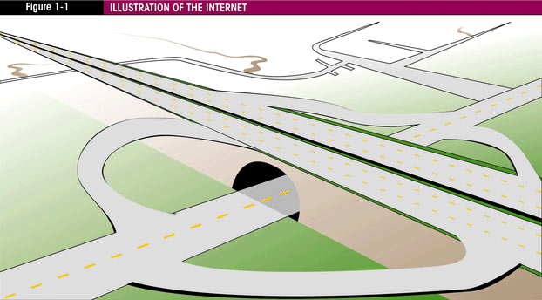
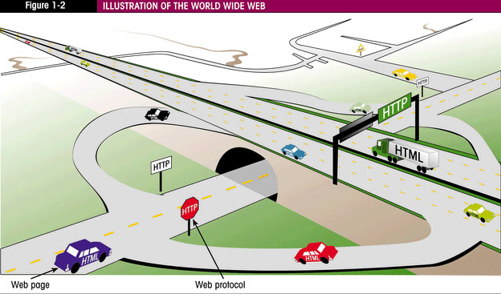
The Internet and the Web
The Web is part of the Internet with its own protocol and its own document structure called Hypertext Markup Language (HTML).
Hypertext Transfer Protocol (HTTP) controls the transfer of HTML web pages over the internet.
HTML provides instructions on how to format the Web pages for display.
Notes:
The web page vehicles follow the http rules of the road to travel the internet highways.
Other vehicles follow other rules to share the internet.

Slide 5
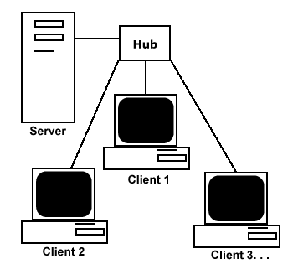
The Client / Server Model
The term client/server dates from the 1980’s (the last millennium!) and refers to personal computers joined by a network.
It can also describe a relationship between two computer programs – the client and the server.
Notes:
Think of a web server as computer waiting for other computers to give it a request e.g. for a web page it then sends the web page to the browser (client who made the request. The most common file it loads is HTML

Slide 6
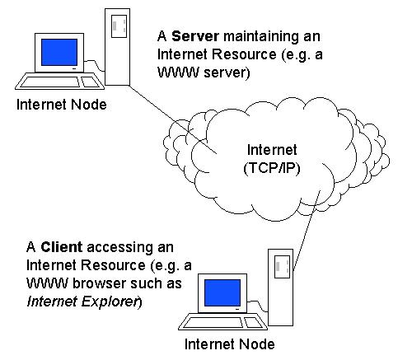
The Client / Server Model
Web Client:
The client requests some type of information (file or database information) from the server.
Web Server:
The server fulfils the request and transmits the results to the client over a network
The Internet is a good example of client/server architecture at work.
Notes:
Client uses web browser ( client) to access Internet
Uses the browser to visit a website (www.yahoo.com)
The Server is the Web server program running on the computer with an IP address that corresponds with Yahoo.com
It locates the Web page and related resources that were requested and responds by sending them to the individual.

Slide 7
The Internet and the Web
Web Client
Connected to the Internet when needed(usually) Runs Web Browser such as IE/FFx
Uses HTTP
Request pages from a server
Receives pages and files from a server
Web Server
Continually connected to Internet
Runs server software such as Apache or Internet Information Server
Uses HTTP
Receives a request for a Web page
Responds to request and sends status code, Web page & files.
Readings: Shuler, R (2005). How Does the Internet Work? http://www.theshulers.com/whitepapers/internet_whitepaper/index.html
Notes:
Apache Web Server: This is a widely-used open source web server originally created by combining all of the NCSA Web server’s patches (fixes) and putting them together. Some claim that it is the world’s most popular web server.

Slide 8
HTTP request–response cycle
1. Open TCP Connection
2. Request + [Entity]
Web Browser
(Client)
Web Server
3. Check Request
syntax
existence
authentication
5. Interpret & Display
6. Close TCP Connection
4. Response + [Entity]
Notes:
Movie Scenario Log onto a web site to see what movies are on
You search by location rather than by movie
You enter zip code A large list of movie theatres appear in your area
You select theatre ––movie times.
In this case you are not doing much The Server web is doing all the work Serving you information
But say web site lets you preview a movie You have to down load QuickTime down load the trailer
Your computer is doing the work that becomes a client side operation. Ordering online is another client operation You put in cart you pay and your computer has to send your credit card details over the web

Slide 9
Internet Service Provider
You must have access to connect to the Internet. Most people connect through an ISP – an Internet Service Provider.
ISP is a company that has direct access to the internet and sells access to smaller entities.
Some larger institutions have direct access and are essentially their own service providers.
Notes:
To view a Web site you must have software known as a Web Browser installed on the client computer

Slide 10
What is a URL
The Uniform Resource Locator - URL -represents the address of a resource that is available on the Internet. (e.g. Web page, graphic file, Java Applet)
An owner of a Website URL has purchased this Domain name uses it to ‘mask’ an IP address which is a numerical number address used to locate and dial up the pages and other items.
Be careful on how you choose your domain name:
E.g.: http://www.penisland.net (sells pens!)

Slide 11
Components of a URL
Uniform (Universal) Resource Locator (URL):
http://www.bond.edu.au/mywebsite/index.html
Webpage name
and file extension
HTTP protocol
Domain name
Folder name
Notes:
Originally envisioned as Universal Resource Locator by Tim Berners-Lee

Slide 12
Domain Names
A domain name locates an organisation or other entity on the Internet.
DNS - Domain Name System – is used to divide the Internet into logical groups and names that can easily be understood.
DNS identifies the exact address and type of organisation.
The DNS associates the text-based names with the unique numeric IP address assigned to the device.

Slide 13
Domain Names
www.yahoo.com
.com =Top level Domain (TLD) Can be .com for commercial
or country code .au for Australia
yahoo = Second level domain
www.=Web (host) server
www.yahoo.com is a Fully-Qualified Domain Name (FQDN)

Slide 14
Top Level Domains
.aero | Air-transport industry
.biz | Businesses
.com | Commercial entities
.edu | Restricted to accredited degree granting institutions of higher education
.info & .net | Unrestricted use/generic
.org | Non profit organisations
.mobi | Corresponds to a .com website for easy access by mobile devices.
For a complete list: http://www.iana.org/domains/root/db

Slide 15
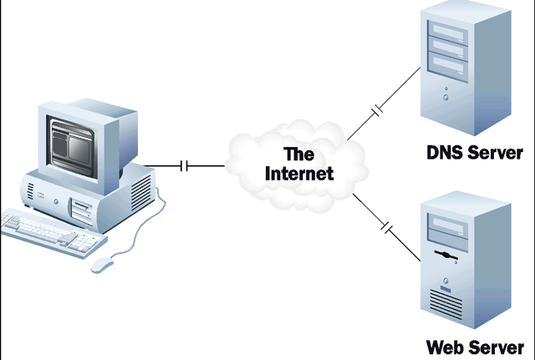
Retrieving a Webpage
The browser uses DNS to determine the IP address of the domain name
Using the HTTP protocol, the browser sends a request to the web server at that IP address for the web page named in the URL
The Web server uses HTTP protocol to receive the request, locates the file requested and transmits the HTML content back to the browser
The browser interprets the HTML and displays the page on the screen

Slide 16
Not all Browsers are created equal
Every browser and each new version of every browser displays web pages slightly differently:
Internet Explorer versions 5, 6, 7 & 8
Safari
Firefox, Opera and more.
Mobile: many different browsers
Web page content must be designed to display correctly in most browsers

Slide 17
Not all Browsers are created equal
The basic rules for translating HTML documents are established by the W3C.
E.g., the HTML standards say that the TABLE tag should support a CELLSPACING attribute to define the space between parts of the table. But standards don't define the default value for that attribute, so unless you explicitly define CELLSPACING when building your page, two browsers may use different amounts of white space in your table.
Notes:
The theory was that Web designers would fall in love with these attributes and put little buttons at the bottom of the page saying, "Best viewed with Netscape Navigator." So Internet users would rush to download that browser and, voila, Netscape would win the Browser Wars.

Slide 18

Browser Statistics
http://www.w3schools.com/browsers/browsers_stats.asp

Slide 19
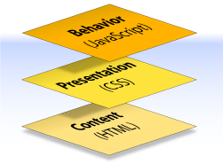
3-teired Architecture
A web document can consist of up to three layers—content, presentation & behaviour

Slide 20
The Content Layer
Comprises the information the author wants to convey
Embedded within HTML or XHTML markup
Content consists of many items including:
Text
Images
Animations
Sound
Video
Etc

Slide 21
HTML vs. XHTML
For many years at the heart of every web page was simple HTML
W3C decided to discontinue using HTML introducing XHTML in its place.
Almost identical to HTML but with stricter syntax.
With the expansion of the Web to include devices other than personal computers, the need for a descriptive rather than structural language became evident - XHTML was created.
Notes:
As web browsers developed with HTML use – they allowed for sloppiness and incorrect code –for example ignoring a missing end tag - they would ignore syntax errors.
Not such a problem for computers but an issue for mobile devices or phones that have less processing power.also HTML is a structural language and does not fit with the uses today.

Slide 22
HTML vs. XHTML
In an interview Tim Berners-Lee, W3C Director and inventor of the Web
http://www.w3.org/2000/01/xhtml-pressrelease
“ XHTML 1.0 connects the present Web to the future Web. It provides the bridge to page and site authors for entering the structured data, XML world, while still being able to maintain operability with user agents that support HTML 4”
Notes:
W3C standard for creating new markup languages that will support the display of non traditional content such as mathematical notation, as well as support the display of non traditional content such as PDA’s and mobile phones.
It is designed to allow the definition of new tags or markup.
It is very exacting because portable devices cannot waste their processing power ‘guessing’ how the page will display

Slide 23
Basic XHTML
<!DOCTYPE html PUBLIC "-//W3C//DTD XHTML 1.0 Transitional//EN" "http://www.w3.org/TR/xhtml1/DTD/xhtml1-transitional.dtd">
<html xmlns="http://www.w3.org/1999/xhtml">
<head>
<title> Untitled Document </title>
</head>
<body> This is where the content of your page will be placed
</body>
</html>
Notes:
XML was designed to transport and store data.
HTML was designed to display data.
http://www.w3schools.com/xml/xml_whatis.asp

Slide 24
XHTML
eXtensible Hypertext Markup Language
Developed by the W3C to reformulate HTML4.01 and the data structures of XML
A primary advantage is that new tags can be created to extend the language and also promise of increased platform interoperability as mobile devices are used more frequently to access the Web.
The next version of (X)HTML 5 is currently being drafted.
http://www.w3.org/TR/html5/
http://www.whatwg.org/specs/web-apps/current-work/
Notes:
XML was developed by the W3C as a flexible method to create common information formats and share this format and info on the Web.
XML is a set of guidelines for delimiting text through a system of tags so it can be read and processed by any device capable of reading text.
Perfect for e-commerce solutions and sending and reviewing data from a data base.

Slide 25
The Presentation Layer
How the content appears and how the document is accessed
CSS is a simple language that works along HTML to apply formatting to content in your WebPages, such as text , images forms etc.
Developed by the W3C, CSS is a really ‘style rules – or style instructions.
Developed to help Web designers bypass the limitations of HTML.
More on CSS in Week 3&4

Slide 26
The Behaviour Layer
Involves real-time user interaction with the document
This task is normally handled by JavaScript but can also be done with other languages like PhP or ASP
The interaction can be anything from a trivial validation that ensures a required field is filled in before an order form can be submitted, to sophisticated web applications that work much like ordinary desktop programs reading and writing from databases etc

Slide 27
Great Book for HTML & CSS
Powell, T. 2010 HTML & CSS: The Complete Reference, Fifth Edition. 5. McGraw-Hill, Inc.

Slide 28
Organising Files

Slide 29
Organising Files
Before you start it is essential that you understand file management and conscious organization.
Very small sites can be contained in one folder that contains another subfolder for images (or assets). A large site may require 30 or 40 subfolders to organize images from sound files, movies etc.
Understand clearly which is your root folder.

Slide 30
Types of URL
Relative URL:
file in same folder: next.htm
file in nearby folder: ../chapter3/toc.htm
relative to root: /images/hello.gif
Absolute URL:
folder specified: http://www.bond.edu.au/
exact file specified: http://www.it.bond.edu.au/mysite/index.htm
Notes:
Important

Slide 31
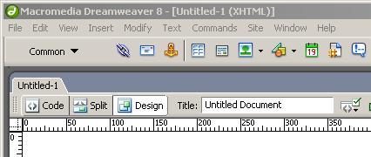
File name and Title name
Saving and naming the page as an HTML file is not the same as titling the webpage.
When you Save As, you are saving as an html file which is a webpage.
Every web page has a name that ends in htm or html (which is how the browser knows it is a web page)

Slide 32
File name and Page Title
The Page Title has nothing to do with the name of the HTML file that has been saved.
It appears in the title bar of the browser window
It is shown when the webpage is bookmarked by a user
Many search engines look at the title of the page first
It must be relevant!
http://blog.dreamhosters.com/2006/07/26/top-10-worst-domain-names

Slide 33
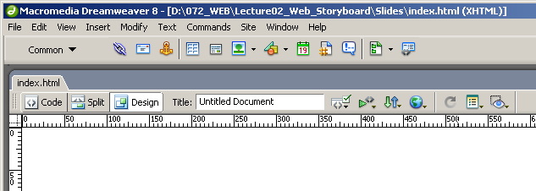
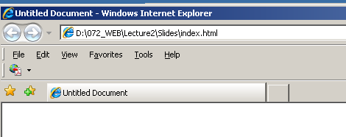
File name and Page Title
File name
Page title

Slide 34
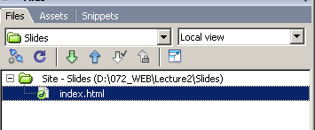
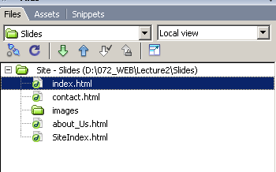
File name and Page Title
The first (intro or home) page of your website should always be index.html (or whatever is specified by your ISP)

Slide 35
Naming your files
Use all lowercase (Camel case!)
Use only letters or numbers, no silly characters
You can use ~(tilde), Underscore_, hyphen-, or period but not / or \ slashes.
Never use a space in any file name.
All web pages must end in .htm or .html
Keep file names as short as possible
Notes:
Camel case practice of writing compound words or phrases in which the elements are joined ...

Slide 36
Some file naming hints
Give a prefix
E.g if your file is a navigation graphic, give it a prefix of ‘nav’ or perhaps a heading banner graphic use ‘hd’
If it is an html file that is part of a category or group of pages give the file name a prefix of ‘a’ or ‘x’ for example:
( xlyrics.html and xmedia.html)

Slide 37
Getting Started Focus on Web Design

Slide 38
The Design Process
First two main steps
Discovery
Implementation

Slide 39

1. Discovery
Gather information
Meet the clients, what do they do?
Communication / Listen more than talk
Pad and paper (less threatening than a lap top –perhaps use a voice recorder?
Meeting over coffee or lunch can relax the client and make it more informal – use your discretion for appropriateness.

Slide 40

Discovery
Do a ‘Search’ of the client before the meeting but still ask the following questions.
What does your company do?
Is there an existing Website for the company?
What does the company hope to achieve with this Website development/ re-design?
What words would you use to describe the ‘feel’ of the website you want – what words do you use to describe your company?
Who are your competitors and do they have websites?
Does the company have an existing logo or brand?
What information do you wish to provide online?
Who comprises your target market?
avoid technical jargon at this stage – e.g. fluid or fixed layouts, colour schemes, etc

Slide 41
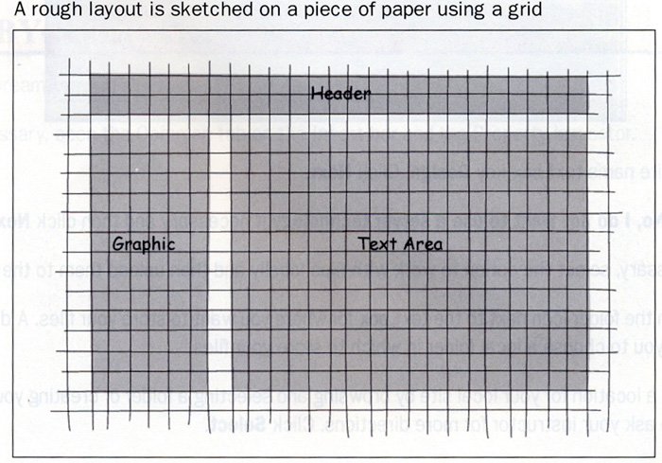
2. Implementation
Take what you have learnt and create a design mock-up
At this stage it should not matter if the design requires basic HTML or full programming – you are designing an interface
If you go straight to the computer it is easy to lose focus.
Place items in your design so that EVERYTHING IS ENCLOSED IN A BOX! (RECTANGLE)

Slide 42
2. Implementation
Grids are a conceptual design tool that divides a page into rows and columns that help structure the layout of the page.
Use any number of squares.
The Rule of Thirds

Slide 43
2. Implementation
Go to Fireworks
And using the rectangle tool to block out areas of colour/text - experiment with backgrounds, colours, etc until you have a limited but pleasing colour scheme.
Don’t forget to include links and rollovers in your colour scheme –
Layout until you have a ‘comp’ to show the client

Slide 44
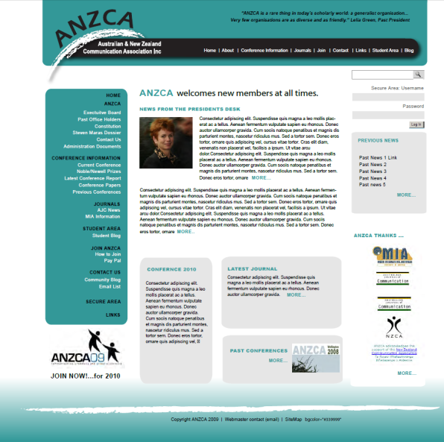
2. Implementation
The Client ‘Comp’
Is an abbreviation of the term ‘comprehensive dummy’ (from the print world)
For web – it is an image of the web design created before we begin to prototype the design in HTML

Slide 45
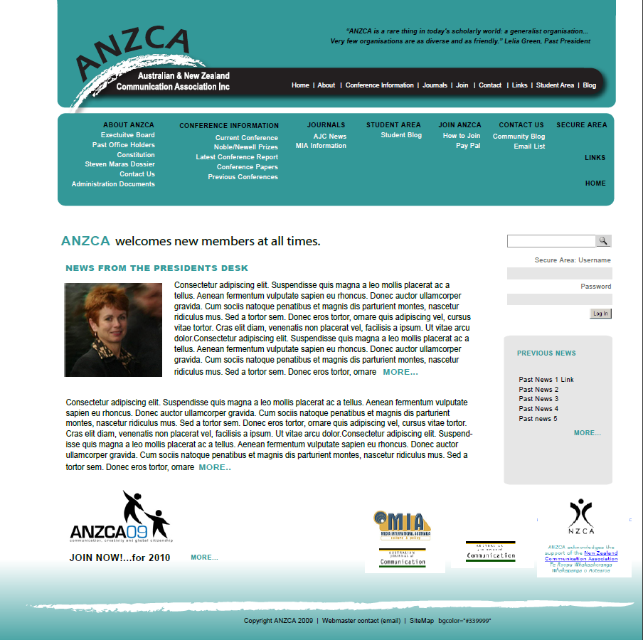
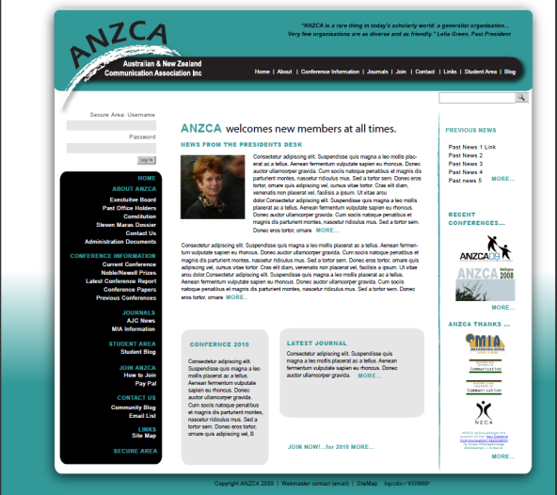
ANZCA comps

Slide 46
Purpose of your Website?
The reason for the Website to exist should be clear and concise:
Advertising
E- commerce
Information
On line catalogue for an existing business
E-business only

Slide 47
Planning Ahead
What are you trying to say with the website?
Start by creating a sentence that sums up your intention:
“To chronicle the world's first voyage around the world by hot air balloon”
Notes:
An advantage of the web compared to traditional media is availability. The web is available 24 hours a day to a global audience. This creates an opportunity to provide valuable information for your customers.

Slide 48
Who is the target audience?
Defining your target audience is crucial to the initial phase of website planning.
People use different browsers, different connection speeds and may or may not have media plug-ins.
What do I want this site to accomplish?
Remember: It is impossible to create a website to suit everyone in the world!

Slide 49
Target Audience
Who are your visitors going to be?
Gender and Age?
Employment?
Education level?
Disposable Income?
Will they be visiting the site many times a day or only occasionally?
Can you step into their ‘virtual shoes’?

Slide 50
A Website Persona
‘Sally is 25 years old, and is studying engineering at college. She is interested in the environment but has only a limited understanding of Global warming. However, if made more aware of the issues, she would like to get involved somehow. Sally feels intimidated by the variety of ecological organizations and is not sure how to contribute’
Excerpt from The Website Manager’s Handbook by Shane Diffily

Slide 51
Identifying User Needs
What would the audience like “To Do” when visiting the site? - Identify key transactions for a visitor.
What would the audience like “To View” when visiting the site? - Identify informational content required.

Slide 52
Planning your website
The ultimate goal of a successful Web site is a smooth blend of design and editorial content with interface functionality and a solid backend system.
Good design is much more than decoration, this delicate balance is invisible to the user when done correctly and painfully obvious when it’s done wrong.

Slide 53
Analysis of a Web Design
What is the purpose of the site?
Who is the intended audience?
Do you think the site reaches its intended audience? Why or why not?
Is the site useful to you?
Why or why not?
List one interesting fact that the site addresses.
Would you encourage others to visit this site?
How could this site be improved?

Slide 54
Sites of Interest
Top 40 of Website Designs
http://designcharts.com/
Website Awards
http://www.thefwa.com
Worst Websites
http://www.webpagesthatsuck.com/

Slide 55
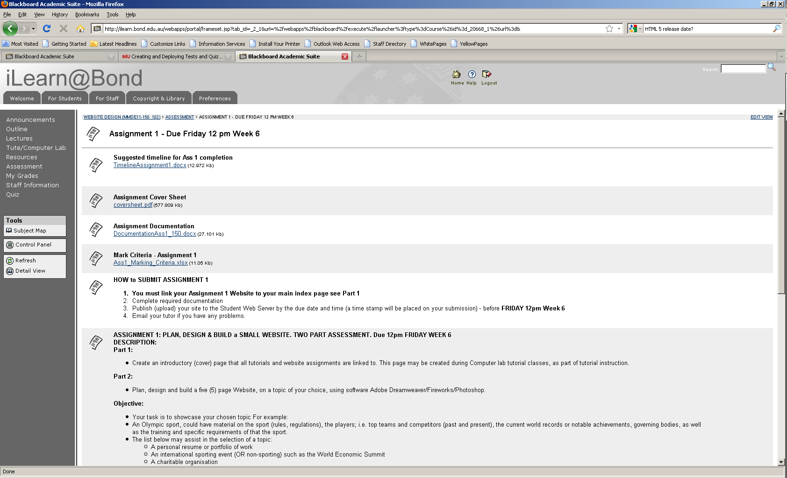
Assignment One

